Slide 1
MediPriority Our AI-Driven Healthcare ECO-SYSTEM
Supporting Material
Made by: Sneh Shah, Neel Shah, Pankil Soni
Institute name: Chandubhai S Patel Institute of Technology
Mentor: Prof. Nirav Bhatt

Slide 2
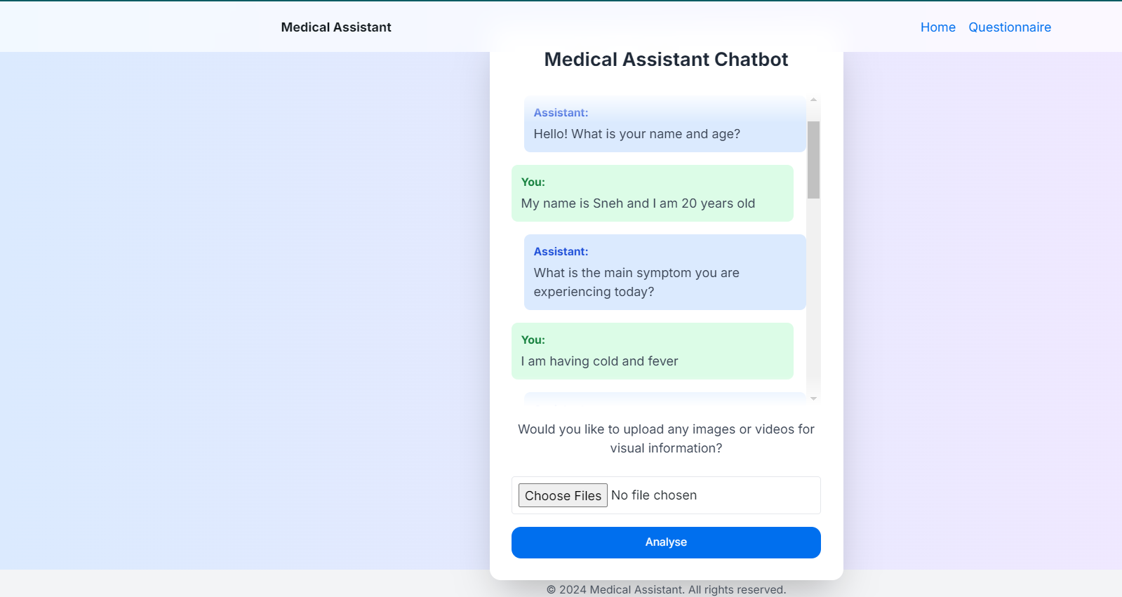
UI for Assistant chatbot and to take visual information

Slide 3
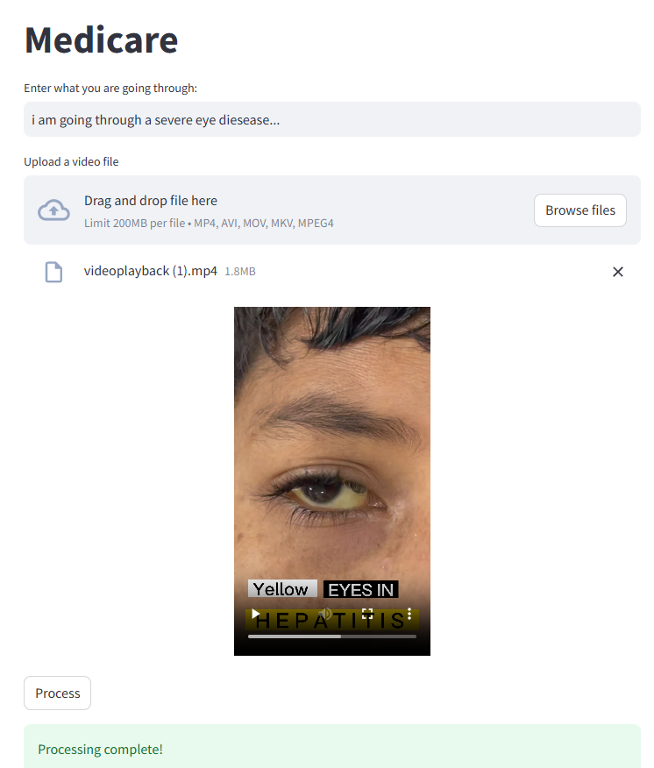
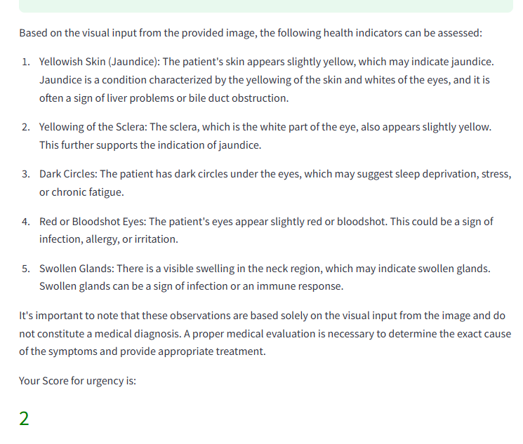
Example analysis of visual agent

Slide 4
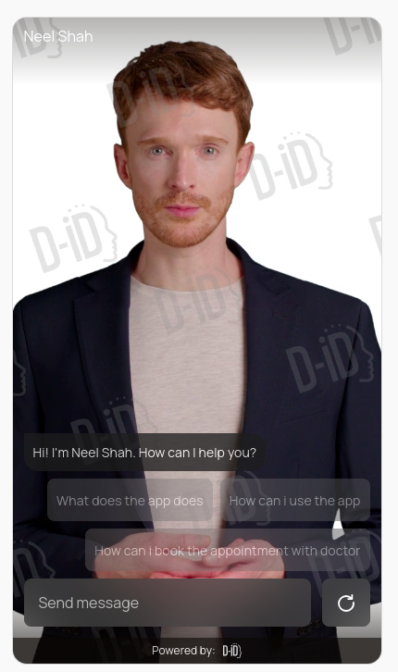
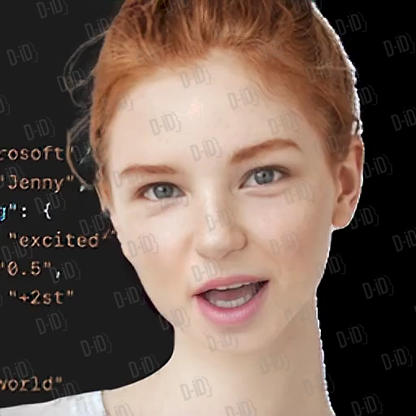
Ai remedies recommender avatar
Live visual recommender avatar

Slide 5
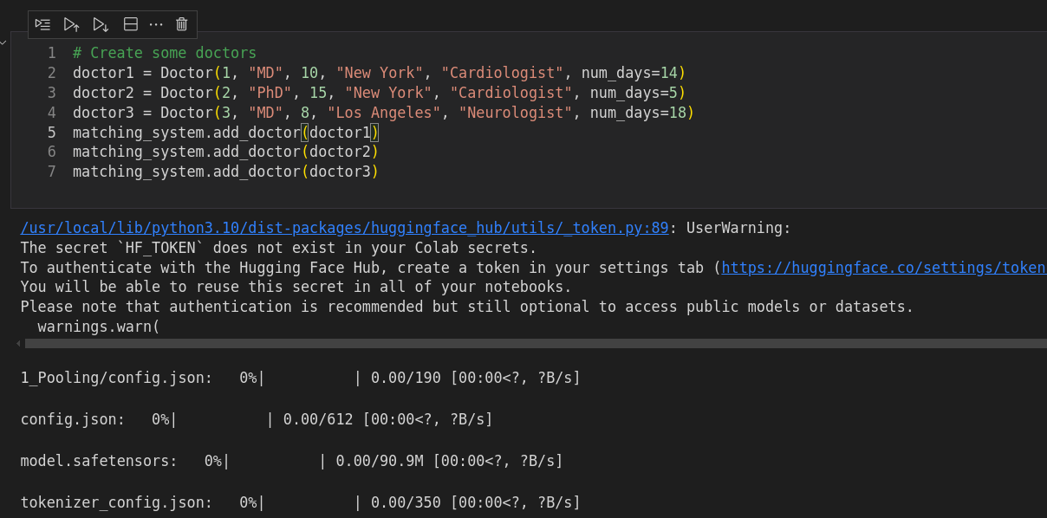
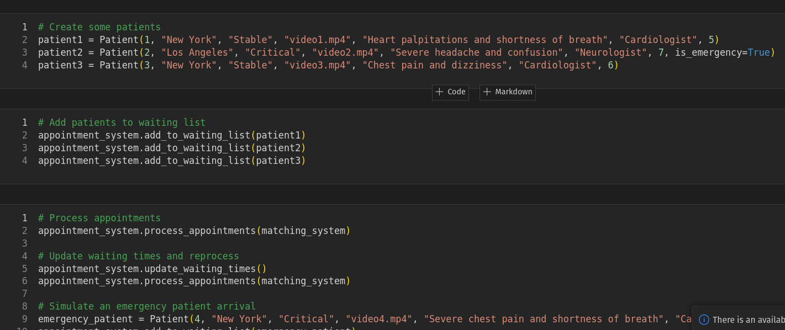
Dynamic Patient slot booking
Inserting patient data and adding them to the
waiting list
Creating doctor data

Slide 6
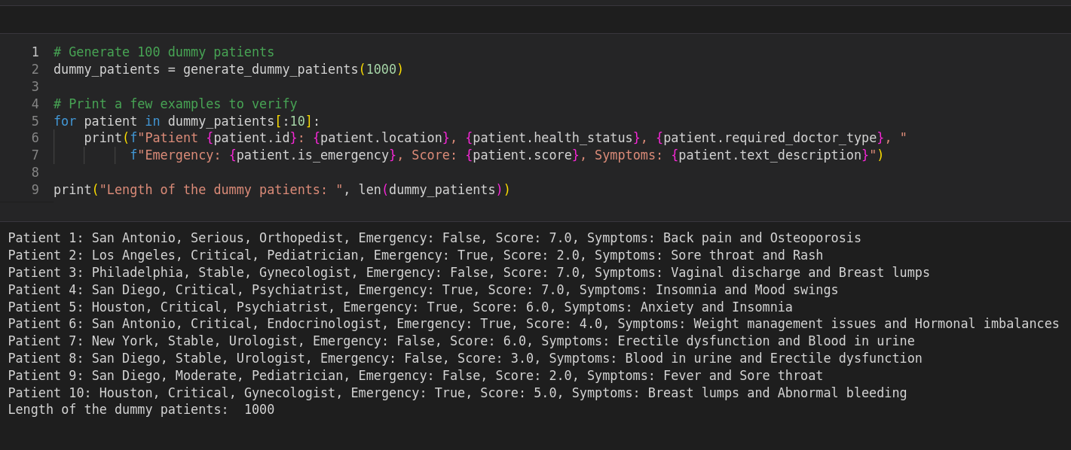
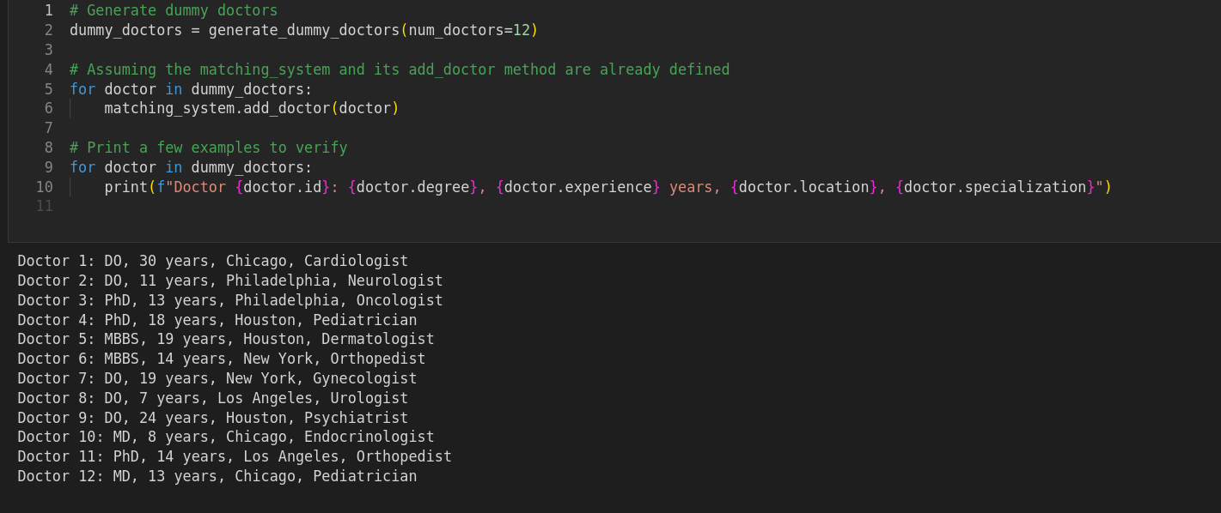
Dynamic Patient slot booking
Creating dummy data for real-life with 1000 patient and 12 doctors

Slide 7
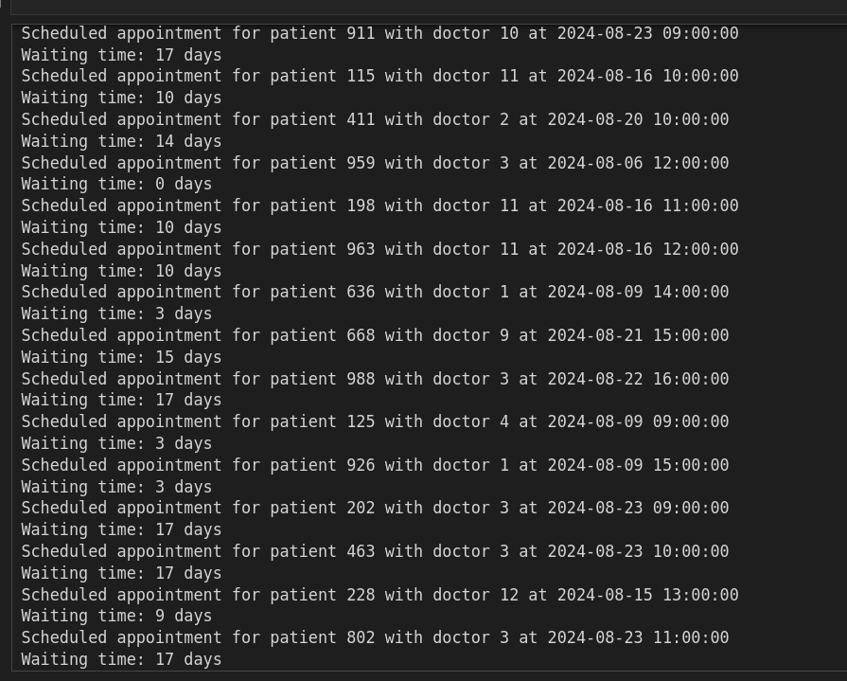
Dynamic Patient slot booking
Allocating time to the patients

Slide 8
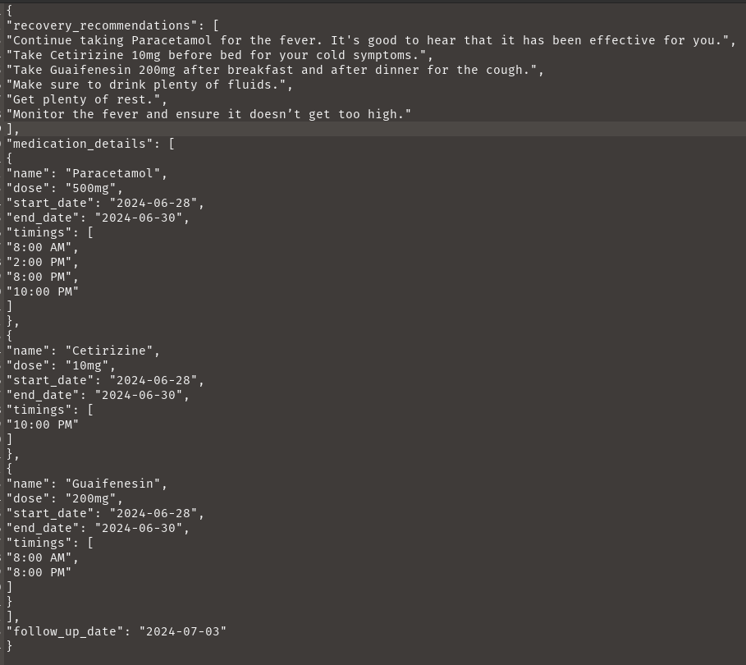
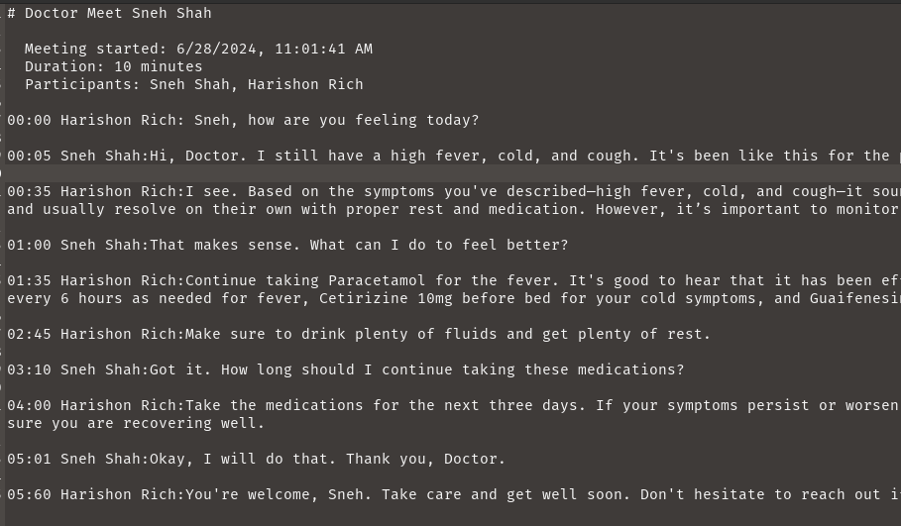
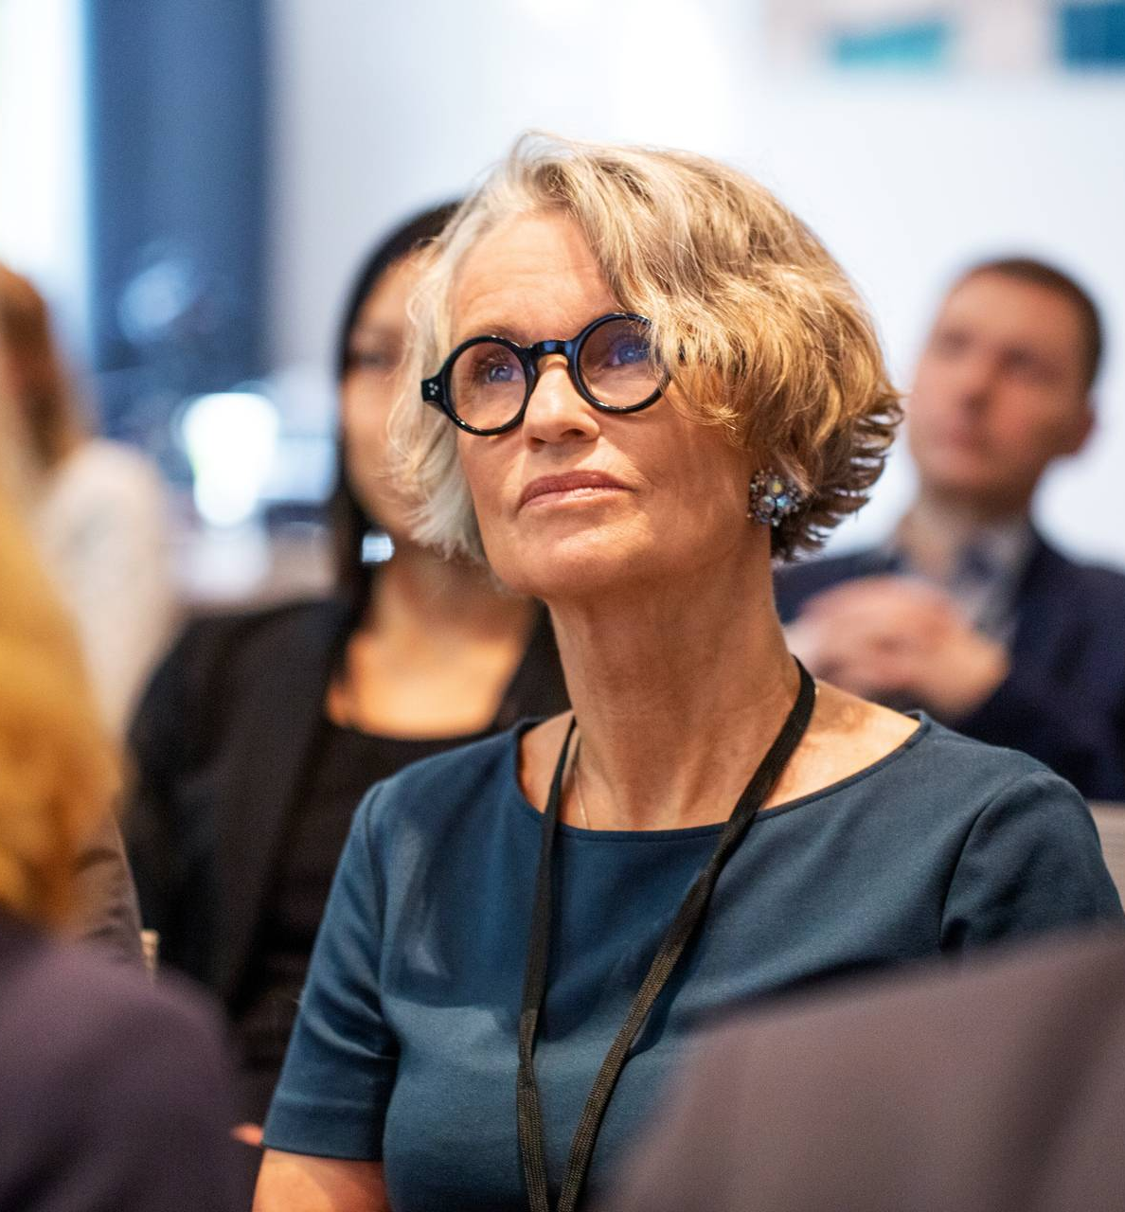

Slide 9
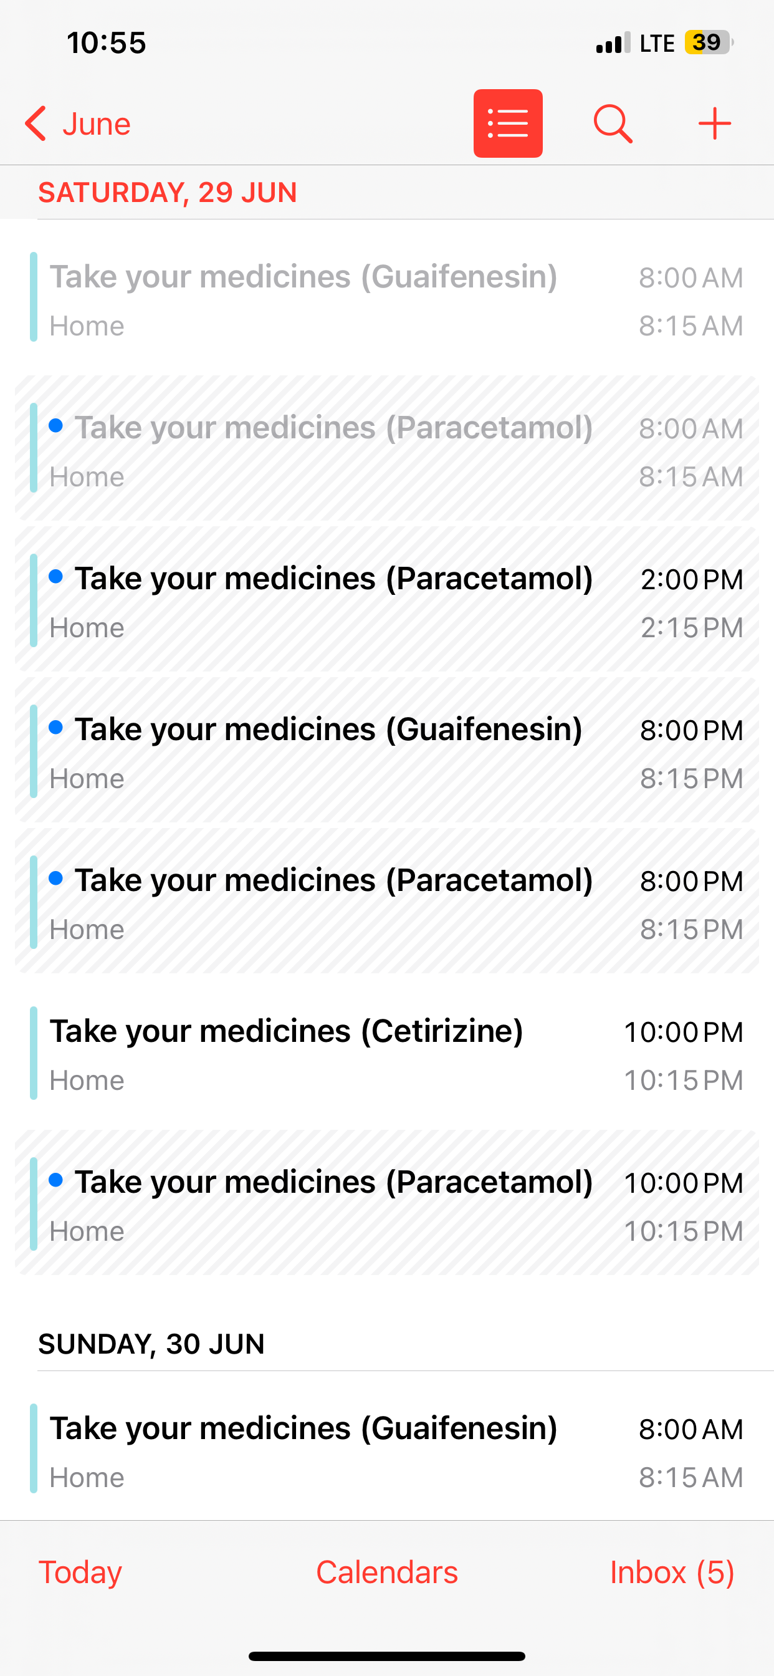
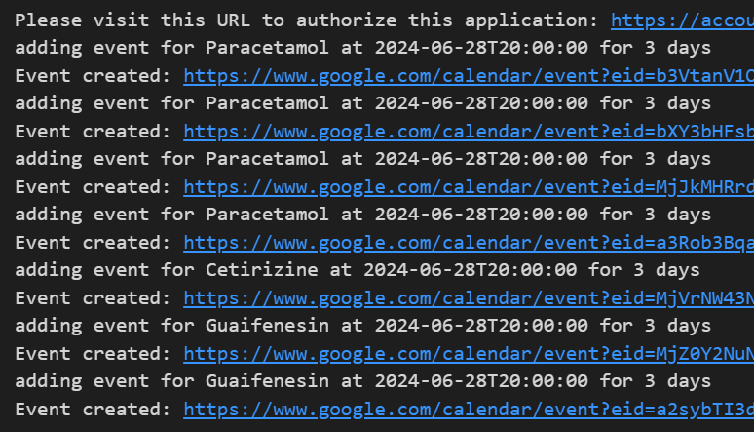
Creating google calendar reminders for medicines and appointments

Slide 10
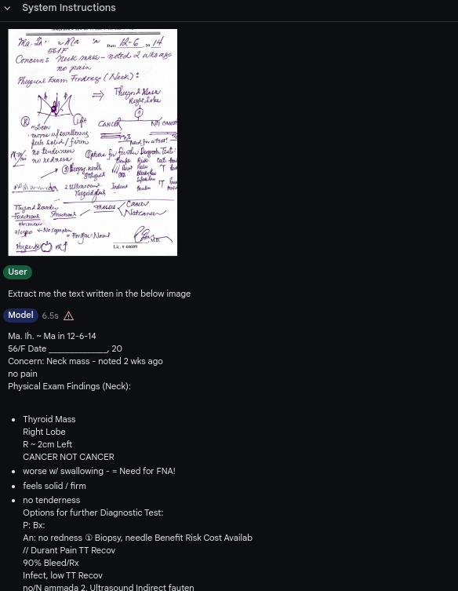
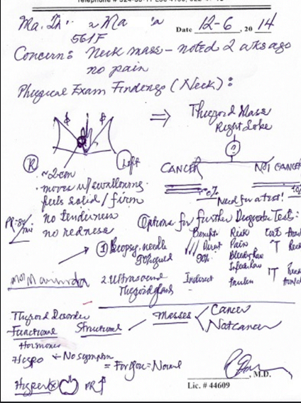
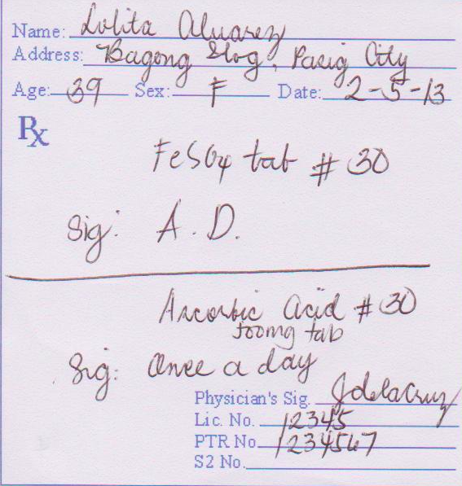
Analysis of Prescription

Slide 11
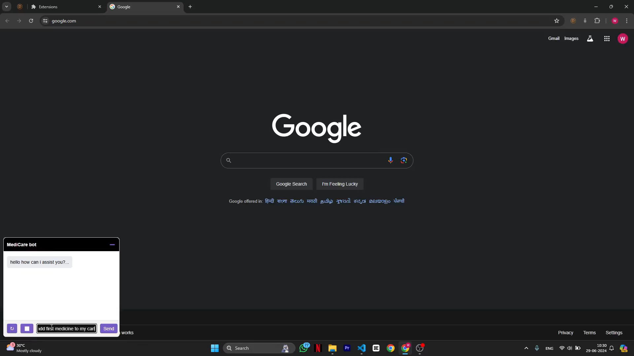
Medicine Ordering bot

Slide 12
Future scope
Add more interpretability and fairness to all of the AI models.
Experiment with custom designed models instead of only depending on the LLMs.
Integrate all the existing models with Front-end and back-end and make entire system more scalable.
New features that we are planning
Predictive Health AI: Forecast potential health issues before symptoms appear.
Graph-Integrated Care: Personalized treatment based on genetic/similar profiles.
AI Emotional Support: Advanced chatbots for mental health assistance.

Slide 13
Thank you
Sneh Shah 22aiml049@charusat.edu.in,
Neel shah 22aiml048@charusat.edu.in,
Pankil Soni 22aiml054@charusat.du.in

